Slide 1
Visual Analytics: Definition, Process, and Challenges

Slide 2
About the Authors
Daniel A. Keim
Professor of Computer Science, Data Analysis and Visualization, University of Konstanz
Dr. Keim has published extensively on topics such as information visualization and data mining, and has given tutorials on related issues at several large conferences
He has been editor of TKDE and the Information Visualization Journal
Gennady Andrienko
Lead Scientist at Fraunhofer IAIS, Professor at City University London
Co-authored monographs ‘Exploratory Analysis of Spatial and Temporal Data’, Springer 2006
Co-authored ‘Visual Analytics of Movement’, Springer 2013
Associate Editor of Information Visualization (since 2012), IEEE Transactions on Visualization and Computer Graphics (2012-2016), and International Journal of Cartography (since 2014)
Jean-Daniel Fekete
Senior Research Scientist, INRIA Saclay, University of Paris Saclay
Developed the Infovis Toolkit, a Java toolkit to facilitate the design of information visualization interfaces.
Served as the general chair of the IEEE VisWeek 2014 conference (Paris, France).
Jörn Kohlhammer
Head of Department, Fraunhofer IGD
Serves as a regular member of program committees for conferences like IEEE VAST and EuroVis, and acts as reviewers in many conferences and journals
His research interests include decision-centered information visualization based on semantics, and visual business analytics

Slide 3
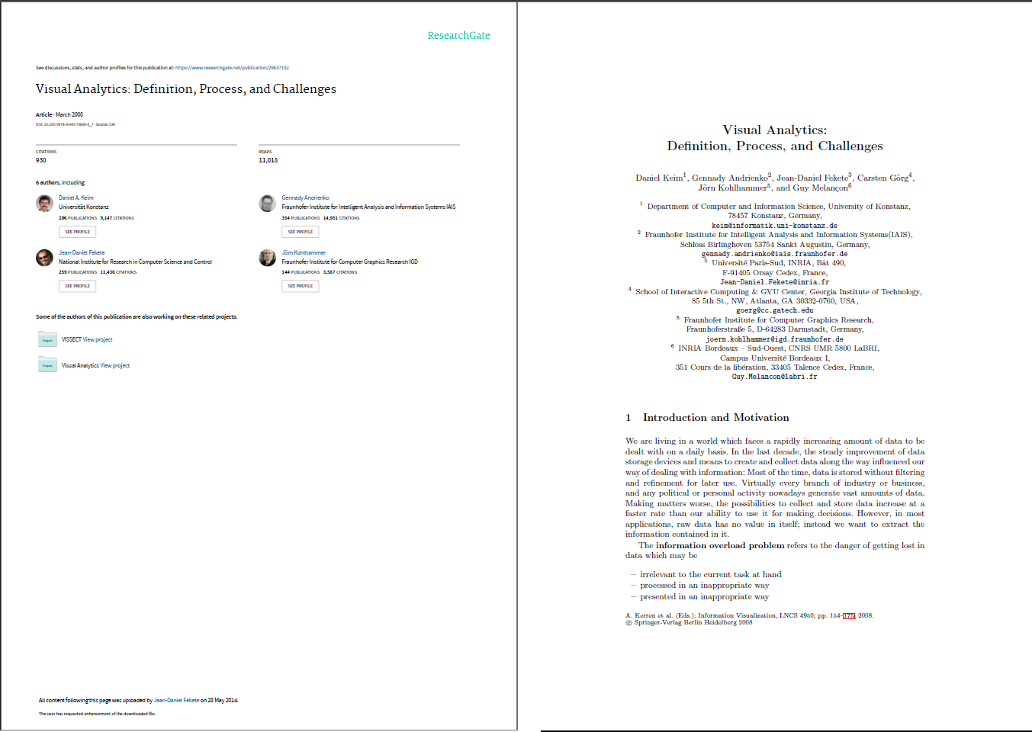
https://www.researchgate.net/publication/29637192_Visual_Analytics_Definition_Process_and_Challenges?enrichId=rgreq-be1986c02bdb362c5f3c5bec1cae990d-XXX&enrichSource=Y292ZXJQYWdlOzI5NjM3MTkyO0FTOjEwMTc2NTcxMDA5MDI1MkAxNDAxMjc0MjQ1MDgx&el=1_x_3&_esc=publicationCoverPdf

Slide 4
Introduction on Visual Analytics
The research paper discusses the challenges posed by the rapidly increasing amount of data in today's world and the concept of "information overload." It highlights the need to extract valuable information from raw data and the difficulties in doing so. The key points of the research paper are as follows:
Data Explosion
Value in Information
Information Overload
Diverse Data Sources
Timely Access to Information
Challenges in Data Processing
Key Questions
Automated Data Analysis
Visual Analytics
User-Centric Approach
Interdisciplinary Nature

Slide 5
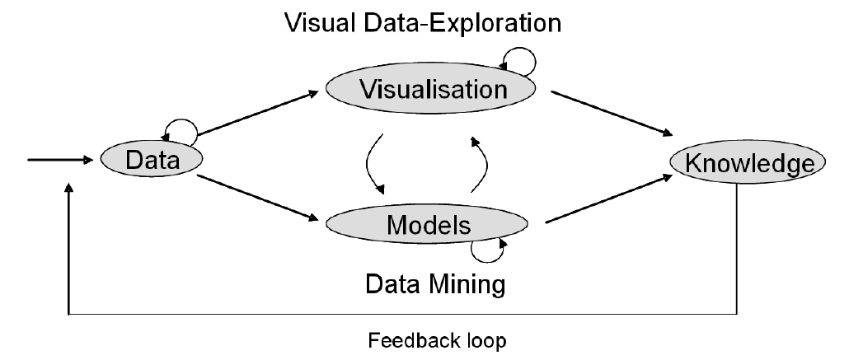
Fig2: Tight integration of visual and automatic data analysis methods with database technology for a scalable interactive decision support.

Slide 6
Definition of Visual Analytics
Visual analytics is defined as the science of analytical reasoning facilitated by interactive visual interfaces. It combines automated analysis techniques with interactive visualizations to enable effective understanding, reasoning, and decision-making, especially for large and complex datasets.
Goals of Visual Analytics: The primary objectives of visual analytics include synthesizing information and gaining insights from massive, dynamic, ambiguous, and conflicting data, detecting both expected and unexpected patterns, providing timely and defensible assessments, and effectively communicating these assessments for action.
Interdisciplinary Approach: Visual analytics is an interdisciplinary field that integrates science and technology from various domains, focusing on solving real-world problems using Information Technology efficiently and effectively.
Benefits of Collaboration: Collaboration between different disciplines in visual analytics leads to better results at the local level of each discipline and forms the foundation for significantly improved solutions in various data analysis applications.
Visual Analytics vs. Information Visualization: Visual analytics extends beyond traditional information visualization. While there is overlap, visual analytics is more comprehensive. It integrates visualization, human factors, and data analysis to develop tightly integrated solutions. The goal is to identify the best automated analysis algorithms for specific tasks and combine them with appropriate visualization and interaction techniques.

Slide 7
Integration of Knowledge Discovery Algorithms: Visual analytics emphasizes the use of advanced knowledge discovery algorithms, which may not have been extensively utilized in traditional visualization work. This approach focuses on solving parts of the problem that cannot be automated and provides solutions to previously unsolvable problems.
User Interaction and Intelligence: Visual analytics places importance on turning user interactions with data into intelligence to enhance analytical processes. For example, systems can adapt based on user behavior, such as adjusting views or influencing clustering algorithms based on user interests.
Data Analytics Priority: Visual Analytics prioritizes data analytics throughout the sense-making process, emphasizing learning from users' behavior and leveraging perception issues to enhance the analytical process.
To conclude, visual analytics is a multidisciplinary field that aims to integrate automated analysis, visualization, and human factors to enable effective decision-making and knowledge discovery from complex datasets. It distinguishes itself from information visualization by its emphasis on data analytics and user interaction throughout the analytical process.

Slide 8
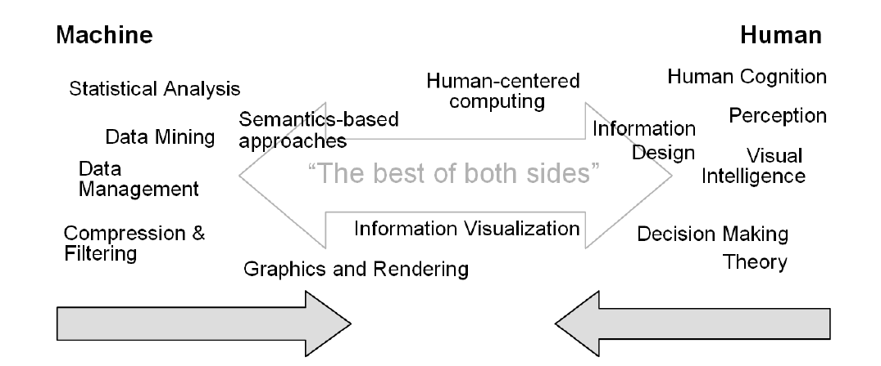
Fig3: Visual Analytics integrates scientific disciplines to improve the division of labor between human and machine

Slide 9
Area Related to Visual Analytics
Visualization
visualization is a research discipline that has two main branches: Scientific Visualization, which deals with 3D geometries and fields with spatial and temporal references, and Information Visualization, which focuses on abstract data with high dimensionality and no natural spatial mapping.
Data Management
Visual Analytics encompasses various research disciplines that converge to enable the effective extraction of knowledge from data. It relies on data management, analysis, human perception, interaction, and evaluation, with specific sub-communities focusing on areas like spatio-temporal data and network/graph data analysis.
Data Analysis
Also known as Data Mining, it involves using automatic analysis algorithms to extract valuable information from raw data. An example of such analysis is, supervised learning where algorithms are used to learn models for the classification or prediction of previously unseen data samples.
Perception and Cognition
The effective utilization of the powerful human perception system for visual analysis tasks requires the careful design of appropriate human-computer interfaces.
Human-Computer Interaction
It involves the design, implementation, and evaluation of interactive systems in the context of the user's task and work. The human-computer interaction is a multi-disciplinary research area that draws on many other disciplines, including computer science, system design, and behavioral science. The goal of human-computer interaction is to improve the interaction between users and computers by making computers more receptive to the users' intentions and needs.
Infrastructure and Evaluation
The research disciplines in visual analytics require cross-discipline support regarding the evaluation of the found solutions and need certain infrastructure and standardization grounding to build on effectively. There is a need for general understanding of the taxonomies to effectively evaluate the found solutions and the importance of infrastructure and standardization.

Slide 10
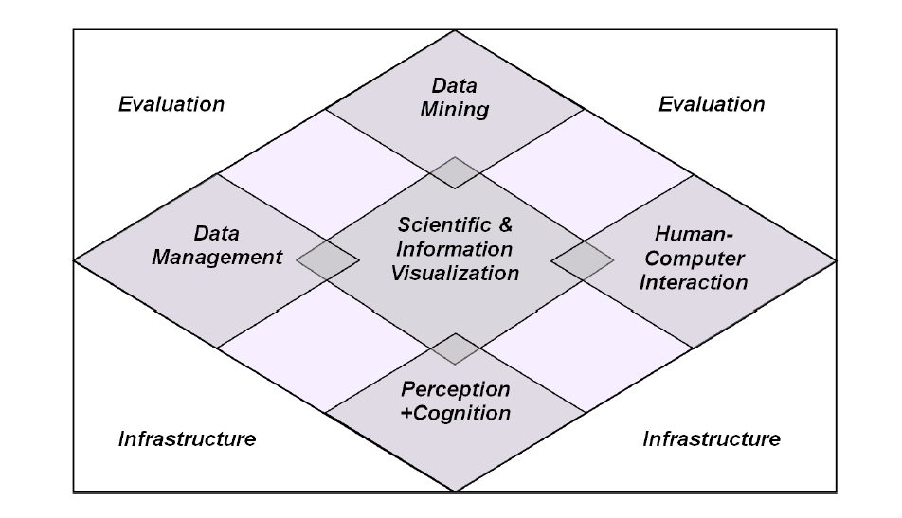
Fig4: Visual Analytics integrates Scientific and Information Visualization with core adjacent disciplines

Slide 11
Visual Analytics Process
Mantra Evolution: Shneiderman's original mantra, "Overview first, Filter and zoom, Details on demand," emphasizes the importance of visualization in the knowledge discovery process.
Starting with Analysis: The computation of any visual representation or geometrical embedding of complex datasets begins with analysis.
Interactive Exploration: Visual Analytics promotes an interactive loop where users can manipulate data to gain insight into both the data and the representation itself.
Sense-Making Loop: The sense-making loop is a fundamental structure in the knowledge discovery process supported by Visual Analytics.

Slide 12
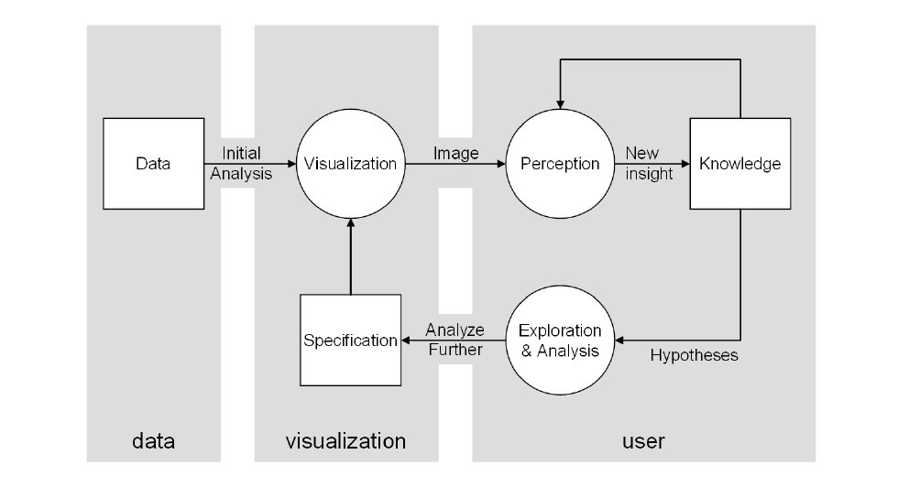
Fig5: The sense-making loop for Visual Analytics based on the simple model of visualization by Wijk

Slide 13
Application Challenges of Visual Analytics
Engineering Domain: Visual Analytics can accelerate product development by providing intelligent access to complex information gathered during prototype development, experiments, and customer feedback. It aims to analyze production system complexity and its correlation with output to enhance production environments.
Financial Analysis: This domain benefits from Visual Analytics by unifying heterogeneous data streams, including news feeds, real-time trading data, and economic indicators. The goal is to offer analysts a task-centered view of diverse financial information, leveraging insights from Information Visualization.
Socio-economic Considerations: Visual Analytics can help in understanding the complex interrelationships between political decisions, economics, culture, and demographics. Geo-spatial analysis frameworks can be utilized for effective analysis and visualization in this area.
Public Safety & Security: Analysts in this domain need to monitor large volumes of heterogeneous information streams, assessing public safety and responding to alarming situations. Visual Analytics offers tools for integrating, correlating, and analyzing data to enhance efficiency in security analysis.
Environment and Climate Change: Visual Analytics is valuable for studying long-term weather records, sensor data, and patterns related to environmental changes and climate. It allows for graphical access to historical monitoring data and model predictions to validate patterns over time.

Slide 14
Technical Challenges of Visual Analytics
Scalability with Data Volumes and Data Dimensionality: Visual Analytics techniques must scale to handle large and high-dimensional input data, including high-resolution data and continuous data streams. Integration of heterogeneous data sources and various data types is crucial. Efficiency in visual representation algorithms is essential for interactive systems.
Quality of Data and Graphical Representation: To prevent misinterpretations, Visual Analytics solutions need to account for data uncertainties, errors, and analysis algorithm limitations. Data quality and analysis confidence should be transparent to analysts throughout the process.
Visual Representation and Level of Detail: Effective solutions must intelligently combine detailed visualizations with global overviews to handle extensive data streams. Visualization should adapt to different levels of detail and offer appropriate data and visual abstraction.
User Interfaces, Interaction Styles, and Metaphors: Visual Analytics systems should offer user-friendly interfaces and interaction styles that allow analysts to focus on tasks without distractions.
Display Devices: Visual Analytics systems should be compatible with various display devices, including high-resolution desktop displays, large-scale power walls, and portable devices.
Evaluation: Given the complexity and diversity of problem domains in Visual Analytics, the development of a theoretically grounded evaluation framework is crucial.
Infrastructure: Managing large datasets for visualization and analysis requires specialized data structures and mechanisms for memory and disk management.

Slide 15
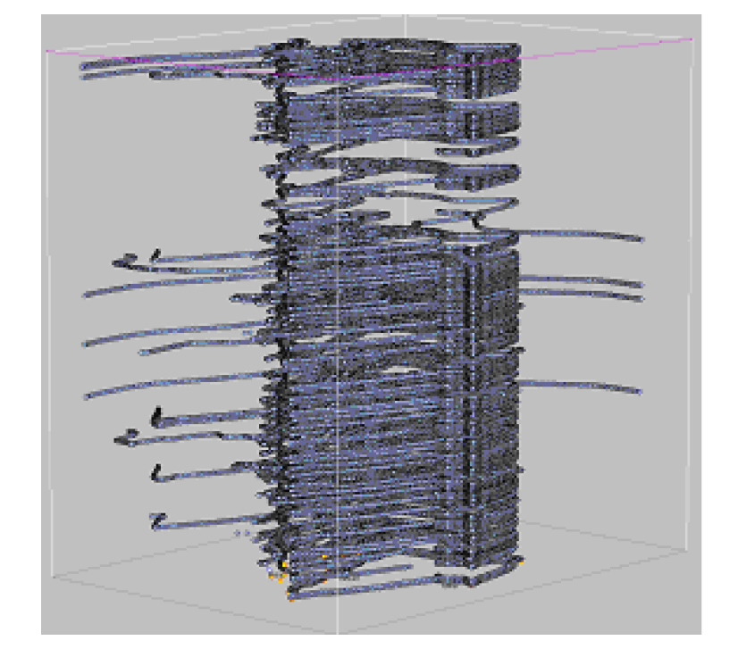
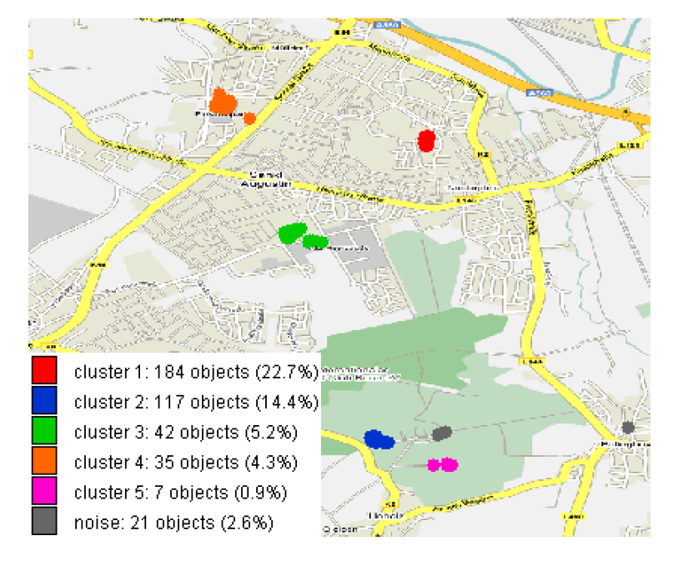
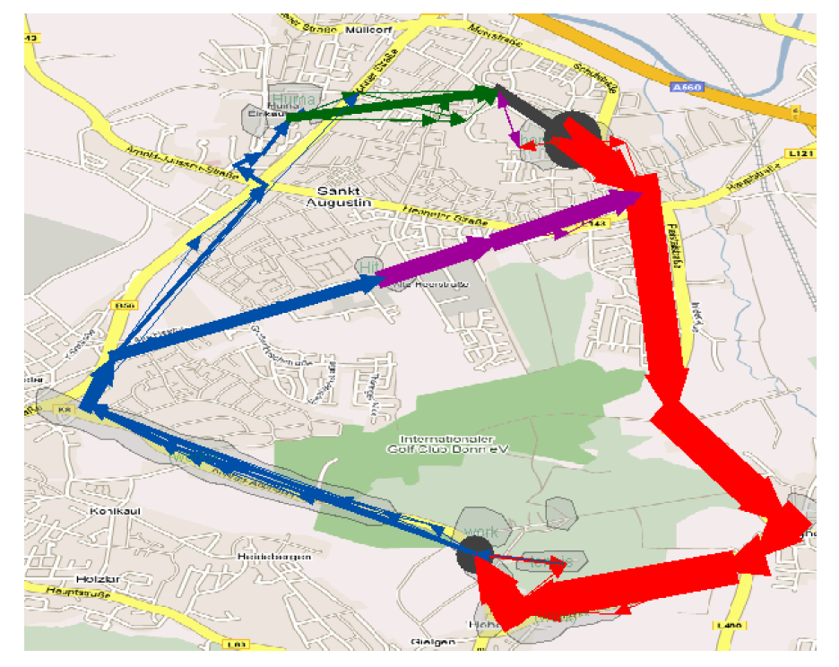
Some examples of Visual Analytics Applications
The application of Visual Analytics tools in the analysis of movement data, primarily involving data from GPS devices, though these datasets contain valuable information for optimizing location and mobility-related infrastructures and services, they lack the necessary semantic context for fully automatic algorithmic analysis.
Fig6: A visual display of a large amount of position records is unreadable and not suitable for analysis
Fig7: Positions of stops have been extracted from the database. By means of clustering frequently visited places have been detected
Fig8: A result of clustering and summarization of movement data: the routes between the significant places

Slide 16
Conclusions
Visual Analytics addresses generic problems that are relevant to virtually all scientific disciplines and many industries.
The fundamental challenge is to transform data into reliable and provable knowledge.
Currently, no single technological approach can claim to provide comprehensive answers to three key questions:
The relevance of specific information.
The appropriateness of data processing methods and the validity of results.
The suitability of the presentation of results for a given task.
Visual Analytics research does not seek a one-size-fits-all solution to these questions. Instead, it draws from various domains, bringing together a range of approaches from different disciplines.
Visual Analytics serves as a bridge that connects different alternative solutions, allowing human users to explore these options within the context of the entire knowledge generation process.

Slide 17
THANK YOU!
Any Questions?
Team Members -
Guha Kanupriya
Madipeddi Rishika Dwipi
Marri Shashank Reddy

